Slide 1



MNIST HANDWRITTEN DIGITS RECOGNITION
TEAM ID- PTID-CDS-MAY22-1315
ANKITA DAS (anki.das23@gmail.com)
KAVITA DESAI (kdarch14@gmail.com)
PRASANT VIJAY KARN (prasantvkarn@gmail.com)

Slide 2
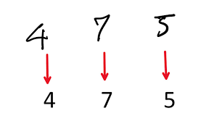
what is handwritten digit recognition?
Handwritten Digit Recognition is the process to provide the ability to machines to recognize
Human
Handwriting.

Slide 3
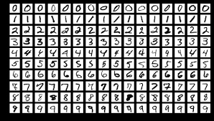
what is mnist dataset?
The MNIST database (Modified National Institute of Standards and Technology database) is a large database of handwritten digits that is commonly used for training various image processing systems. The database is also widely used for training and testing in the field of machine learning. It was created by "re-mixing" the samples from NIST's original datasets. The creators felt that since NIST's training dataset was taken from American Census Bureau, employees, while the testing dataset was taken from American high school students, it was not well-suited for machine learning experiments. Furthermore, the black and white images from NIST were normalized to fit into a 28x28 pixel bounding box and anti-aliased, which introduced grayscale levels.
MNIST contains a total of 70,000 handwritten
digit images (60,000 - training set and 10,000 - test set) in
28x28 pixel bounding box and anti-aliased.
LOADING THE DATASET:
from tensorflow.keras.datasets import mnist
(X_train, y_train), (X_test, y_test) = mnist.load_data()

Slide 4
DATA PREPROCESSING
PREPROCESSING
SEGMENTATION
CLASSIFICATION
INPUT IMAGE
DIGIT CLASS
MULTI DIGIT IDENTIFICATION DIAGRAM
STEPS IN DATA PROCESSING ARE:
CONVERSION TO GRAY SCALE
RESIZING/RESHAPE
ONE HOT ENCODING
CONVERSION TO GRAY SCALE
RESIZING
ENCODING
INPUT IMAGE
PREPROCESSED
IMAGE
PREPROCESSING STEPS

Slide 5

model building using convolutional neural network
MODEL 1 (3 Hidden Layers and with 2 Dropouts)- In Model 1 we got an accuracy of 98.97%.
MODEL 2 (6 Hidden Layers and with 2 Dropouts)- In model 2 we got an accuracy of 98.42%.
MODEL 3 (3 Hidden Layers and without 2 Dropouts)- In model 3 we got an accuracy of 98.65%.
MODEL 4 (6 Hidden Layers and without 2 Dropouts)- In model 4 we got an accuracy of 98.35%.
MODEL 5 (3 Hidden Layers and with 1 Dropouts)- In model 5 we got an accuracy of 98.96%.
MODEL 6 (6 Hidden Layers and with 1 Dropouts)- In model 6 we got an accuracy of 98.69%.
In Data Augmentation Model we got an accuracy of 99.44%.
What is a CNN algorithm?
A convolutional neural network (CNN) is a type of artificial neural network used in image recognition and processing that is specifically designed to process pixel data.

Slide 6
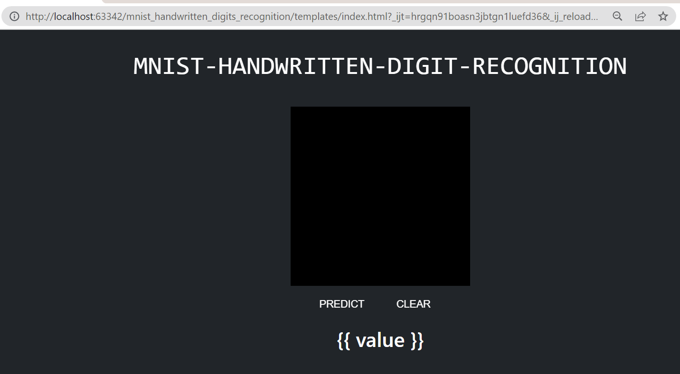
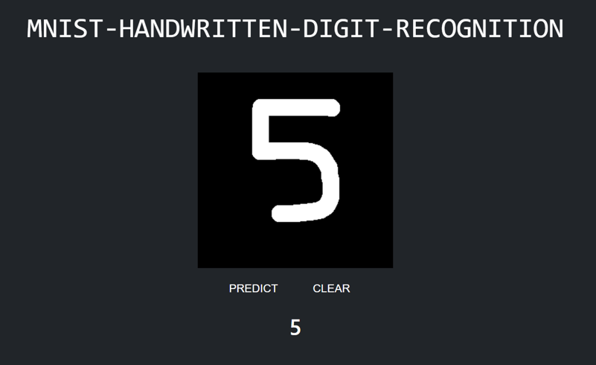
DEPLOYMENT
HTML Interface: http://localhost:63342/mnist_handwritten_digits_recognition/templates/index.html?_ijt=2emphu71rb9buecggjbam8jrt5&_ij_reload=RELOAD_ON_SAVE
API: PyCharm

Slide 7
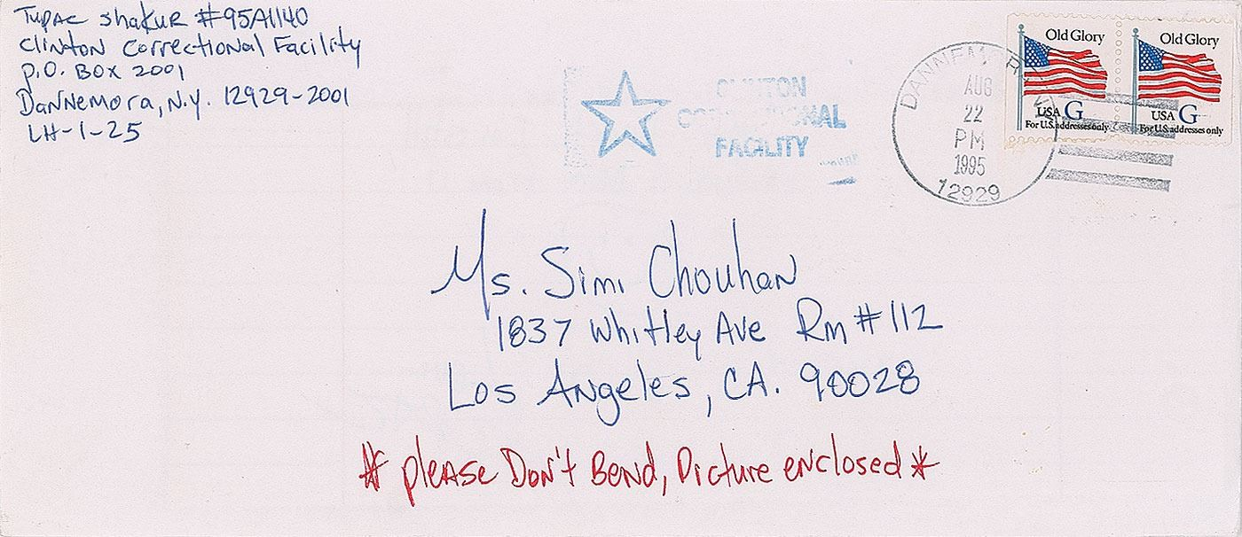
aPPLICATIONS
(a) National ID number recognition system
(b) Postal office automation with code number recognition on Envelope
(c) Automatic license plate recognition
(d) Bank automation.
(e) Data entry

Slide 8
ThANK YOU

